Slide 1
Pertemuan Ke-3
Aritmatika pada Komputer

Slide 2
Issues
Bagaimana dengan bilangan pecahan atau real?
Bagaimana jika suatu operasi menghasilkan nilai yang lebih besar dari yang dapat direpresentasikan?
Bagaimana hardware dapat melakukan operasi perkalian dan pembagian?
real numbers
arithmetic algorithms
hardware
implications to instruction set

Slide 3
Addition
6_{ten} + 7_{ten} = 13_{ten}
0000 0000 0000 0000 0000 0000 0000 0110_{two} = 6
0000 0000 0000 0000 0000 0000 0000 0111_{two} = 7
+ -----------------------------------------------------------------
0000 0000 0000 0000 0000 0000 0000 1101_{two} = 13
7_{ten} + 6_{ten} = 13_{ten}
0000 0000 0000 0000 0000 0000 0000 0110_{two} = 6
0000 0000 0000 0000 0000 0000 0000 0111_{two} = 7
+ -----------------------------------------------------------------
0000 0000 0000 0000 0000 0000 0000 1101_{two} = 13

Slide 4
Subtraction
7_{ten} - 6_{ten} = 1_{ten}
0000 0000 0000 0000 0000 0000 0000 0111_{two} = 7
0000 0000 0000 0000 0000 0000 0000 0110_{two} = 6
- -----------------------------------------------------------------
0000 0000 0000 0000 0000 0000 0000 0001_{two} = 1
Atau gunakan 2’s complement
7_{ten} + (-6)_{ten} = 1_{ten}
111111111111111111111111111111111 carries
0000 0000 0000 0000 0000 0000 0000 0111_{two} = 7
1111 1111 1111 1111 1111 1111 1111 1010_{two} = -6
+ -----------------------------------------------------------------
0000 0000 0000 0000 0000 0000 0000 0001_{two} = 1

Slide 5
Instruction sets: Addition, Subtraction
Intel: Integer, non-SIMD
ADD – add
ADC – add with carry
SBB – Integer subtraction with borrow
SUB – subtract
INC - increment
MIPS:
Signed integer: add, addi, sub
Unsigned integer: addu, addiu, subu

Slide 6
Multiplication
Multiplicand 1000_{ten}
Multiplier x 1001_{ten}
-----------
1000
0000
0000
1000
--------------
Product 1001000_{ten}
Banyaknya digit hasil perkalian menjadi lebih banyak

Slide 7
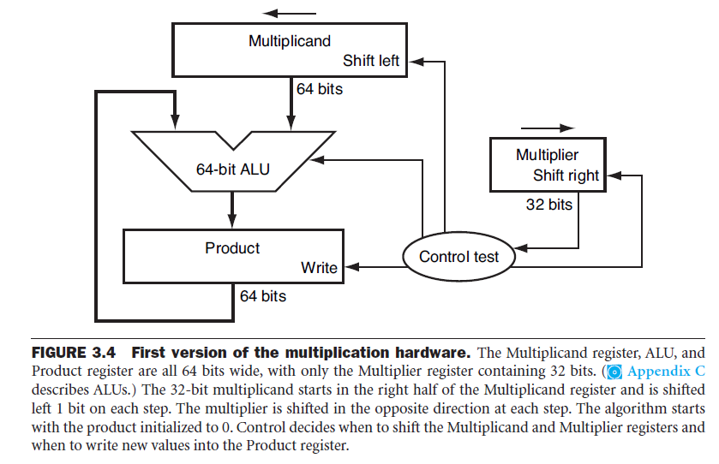
Sequence Version multiplication algorithm and hardware

Slide 8
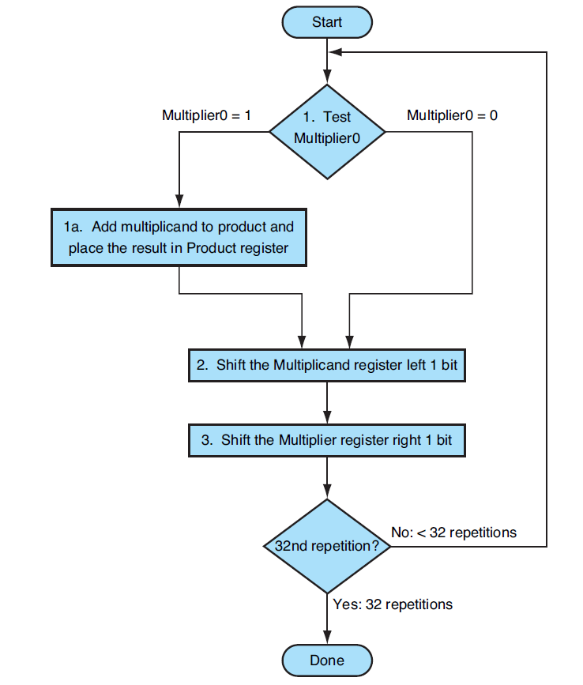
Multiplication algorithm

Slide 9
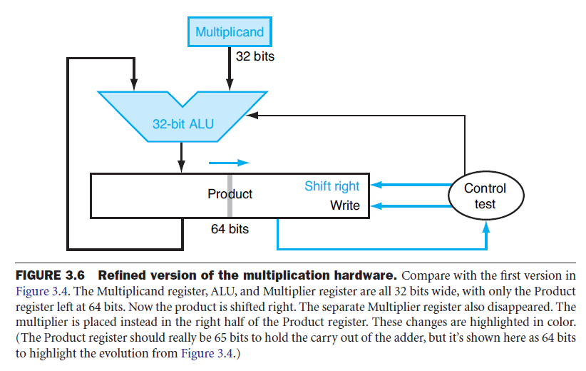

Slide 10
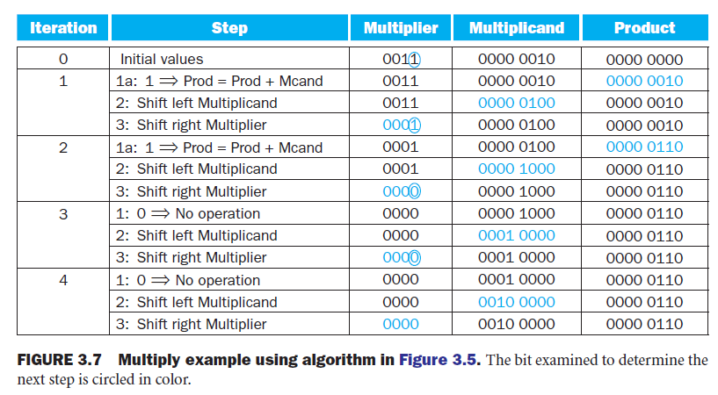
Signed Multiplication
2 x 3 = 6

Slide 11
Instruction Set Architecture: Multiplication
Intel: Integer
IMUL: signed multiply
MUL: unsigned multiply
SHL: Shift logical left
SAL: Shift arithmetic left
MIPS:
mult: multiply
multu: multiply unsigned

Slide 12
Bagaimana perkalian berikut dalam biner:
7_{ten} x 2_{ten}
3_{ten} x 3_{ten}
Instruksi mana yang dapat digunakan, jika menggunakan prosesor Intel?

Slide 13
Division
Dividend = Quotien x Divisor + Remainder
1001010_{ten} di bagi 1000_{ten}
1001_{ten} Quotient
-----------
Divisor 1000_{ten} : 1001010_{ten} Dividend
-1000
-------
10
101
1010
- 1000
----------
10_{ten} Remainder

Slide 14
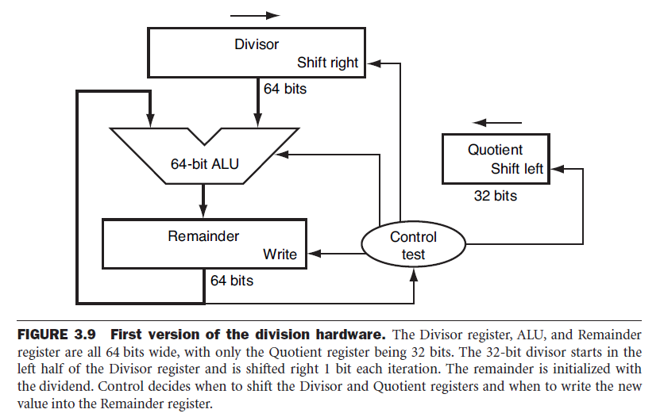

Slide 15
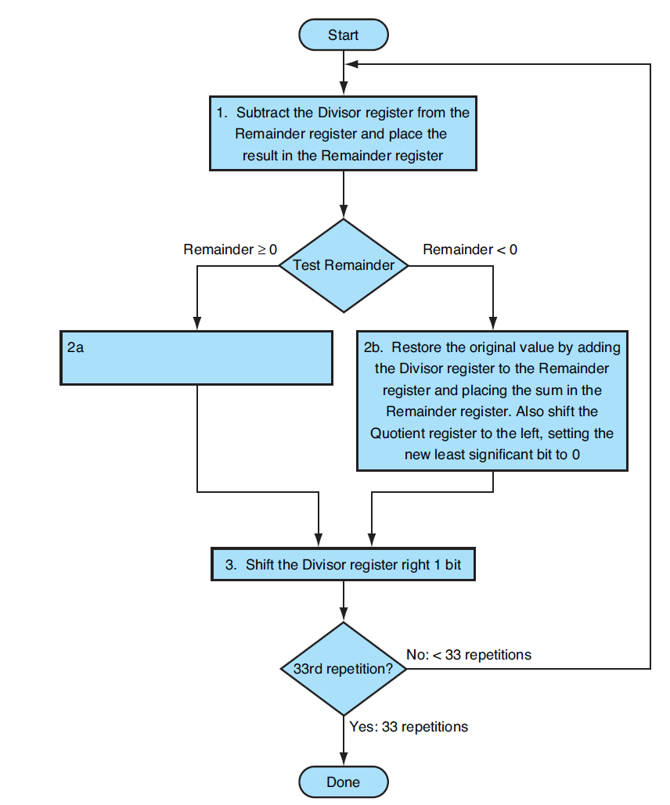

Slide 16
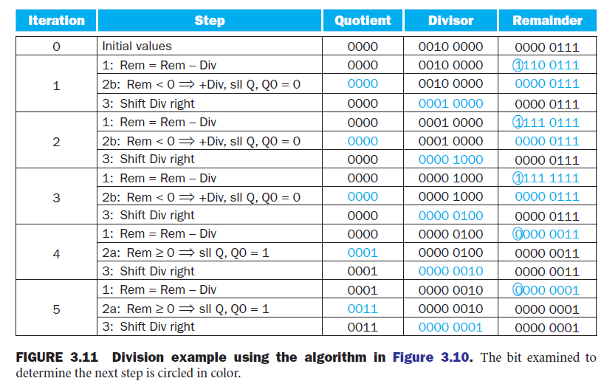
7_{ten} ÷ 2_{ten}, 0000 0111_{two} ÷ 0000 0010_{two}

Slide 17
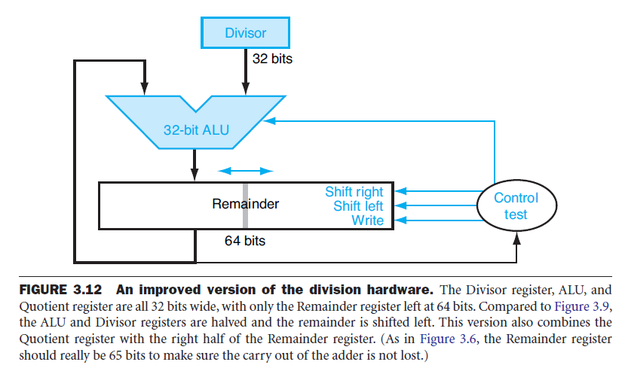

Slide 18
Signed Division
Signed divison lebih kompleks, karena melibatkan tanda
Positive/ tak bertanda: 7 = Q(3) + D(2) + R(+1) = 6 +1
Bertanda: -7 ÷ 2, Quotient = -3
Remainder = (Divident – Quotient x Divisor) , maka
-7 – (-3 x +2) = -7 – (-6) = -1
-7 ÷ +2, Quotient = -3, Remainder = -1, periksa
-7 = -3 x +2 + (-1) = -6 – 1
Bagaimana dengan yang ini?
7 ÷ -2, Quotient = -3, Remainder = +1
-7 ÷ -2, Quotient = +3, Remainder = -1

Slide 19
Instruction Set Architecture: Division
Intel: Integer
DIV: unsigned divide
IDIV: signed divide
SHR: Shift logical right
SAR: Shift arithmetic right
MIPS:
div: signed integer
divu: unsigned integer

Slide 20
Contoh program: arithemics

Slide 21
Floating point
Bilangan tidak hanya integer, adapula fraction atau dinamakan pula real.
Contoh:
3.14159265_{ten} ….(pi)
2.71828_{ten} …. (e)
Scientific notation: normalized number
0.000000001_{ten} atau 1.0_{ten} x 10⁻⁹ (normalized scientific)
3155760000_{ten} atau 3.15776 x 10⁹
0.1 X 10⁻⁸ dan 10.0 x 10⁻¹⁰ (bukan normalized scientific)
Binary number, not fixed:
1.0_{two} x 2⁻¹
Floating point, dalam bahasa C/C++ dinamakan float.

Slide 22
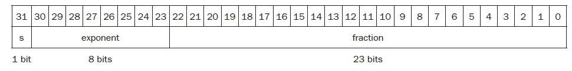
Floating poin representation
Fraction: nilai antara 0 dan 1, sebagai fraction field
Exponent: exponent field
Designer harus melakukan kompromi antara fraction dan exponent.
MIPS:
Exponent, 8 bits, ditambah sign bit
Fraction, 23 bits, dinamakan signed and magnitude
General representation:
(-1)^{S} x F x 2E ; F - fraction field; E – exponent field
Case: overflow (positive), underflow (negative)

Slide 23
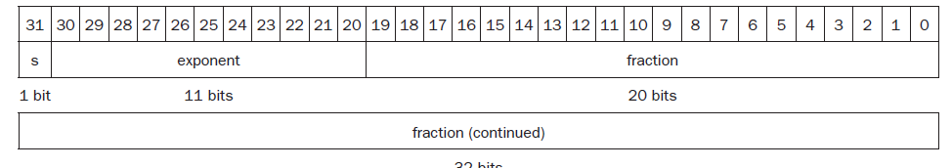
Single precision, dan Double precision
MIPS dan Intel mengadopsi IEEE 754 floating point standard
MIPS: SP: 32 bits, exponent (8 bits), DP: two 32 bits, exponent (11 bits)
1.0_{two} x 2⁻¹
1.0_{two} x 2⁺¹

Slide 24
IEEE 75 floating point standard
General (non-biased notation)
(-1)^{S} x (1 + Fraction) x 2E
(-1)^{S} x (1 + (s1x2⁻¹)+(s2x2⁻²)+(s3x2⁻³)+…) x 2E
Biased notation:
single precison 127, double precision 1023
(-1)^{S} x (1 + Fraction) x 2^{(Exponent-bias)}
Exponent -1, direpresentasikan dalam pola bit:
-1 + 127_{ten}, atau 126_{ten} = 0111 1110_{two}
Exponent +1, direpresentasikan dalam pola bit:
1 + 127_{ten}, atau 128_{ten} = 1000 0000_{two}

Slide 25
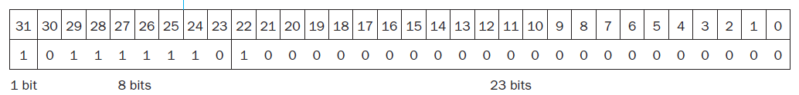
Contoh, IEEE floating point
Representasi -0.75_{ten} atau -3/4_{ten} atau -3/2²_{ten}
-11_{two}/2²_{ten} atau -0.11_{two}
Scientific notation: -0.11_{two} x 2⁰
Normalized scientific notation: -1.1_{two} x 2⁻¹
Representasi umum single precision
(-1)^{S} x (1+Fraction) x 2^{(Exponent-bias)}
Pengurangan bias 127 dari -1.1_{two} x 2⁻¹
(-1)¹ x (1+.1000 0000 0000 0000 0000 0000_{two}) x ²⁽¹²⁶⁻¹²⁷⁾
Double precision:
(-1)1 x (1+.1000 0000 0000 0000 0000 0000 0000 0000 0000 0000 0000_{two}) x ²⁽¹⁰²²⁻¹⁰²³⁾

Slide 26
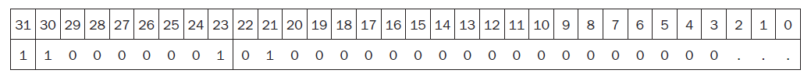
Floating point: konversi binary ke decimal
Sign bit: 1 (minus)
Exponential field: 129
Fraction field: 1 x 2⁻² = ¼ atau 0.25
Persamaan dasar: (-1)^{S} x (1+Fraction) x 2^{(Exponent-bias)}
= (-1)¹ x (1 + 0.25) x 2⁽¹²⁹⁻¹²⁷⁾
= -1 x 1.25 x 2²
= -1.25 x 4
= -5.0

Slide 27
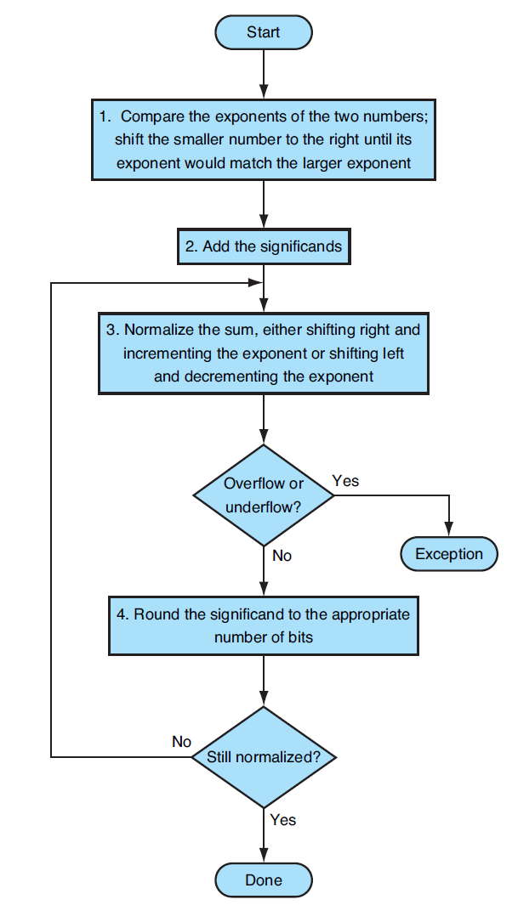
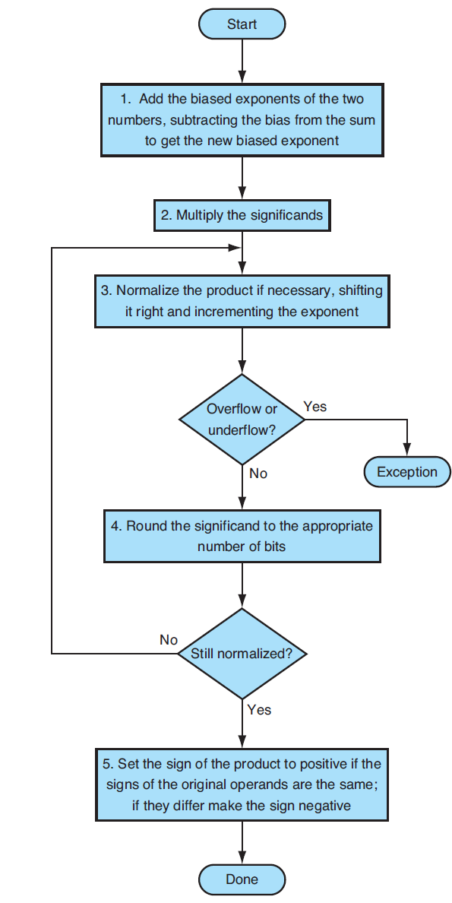
Algorithms
Multiplication
Addition

Slide 28
Floating point: Addition
Gunakan operasi binary untuk: 0.5_{ten} + -0.4375_{ten}
0.5_{ten} = 1/2_{ten} = 1/2¹_{ten}
= 0.1_{two} = 0.1_{two} x 2⁰ = 1.000_{two} x 2⁻¹
- 0.4375_{ten} = -7/16_{ten} = -7/2⁴_{ten}
= -0.0111_{two} = -0.0111_{two} x 2⁰ = -1.110_{two} x 2⁻²
1: -1.110_{two} x 2⁻² = -0.111_{two} x 2⁻¹ (shift right, larger number)
2: 1.000_{two} x 2⁻¹ + (-0.111_{two} x 2⁻¹) = 0.001_{two} x 2⁻¹ (add siginificant)
3: (normalize the sum)
0.001_{two} x 2⁻¹ = 0.010_{two} x 2⁻² = 0.100_{two} x 2⁻³
= 1.000_{two} x 2⁻⁴ (127 ≥ -4 ≥ -126, tidak over/under flow)
4: (Round)
1.000_{two} x 2⁻⁴ = 0.0001000_{two} = 0.0001_{two}
= 1/2⁴_{ten} = 1/16_{ten} = 0.0625_{ten}

Slide 29
Floating point Operations
MIPS:
Addition: add.s, add.d
Subtraction: sub.s, sub.d
Division: div.s, div.d
Multiplication: mul.s, mul.d
Comparison
Intel:
Addition:
Subtraction:
Division:
Multiplication:
Comparison

Slide 30
Floating point pada x86

Slide 31
Parallelism dan Aritmatika Komputer:
Associativity
Yang perlu diperhatikan:
apakah hasil yang akan diperoleh akan dapat dipastikan sama jika dilakukan secara sekuensial
Pengujian: associativity pada floating point
x + (y +z) = (x +y) + z, jika ya maka dapat diparalelisasi
Contoh: x = -1.5_{ten} x10³⁸, y = 1.5_{ten} x10³⁸, z = 1.0
x+(y+z) = -1.5_{ten} x10³⁸ + (1.5_{ten} x10³⁸ +1.0)
= -1.5_{ten} x10³⁸ + (1.5_{ten} x10³⁸ ) = 0.0
(x+y)+z = (-1.5_{ten} x10³⁸ + 1.5_{ten} x10³⁸)+ 1.0
= (0.0_{ten}) + 1.0 = 1.0
x + (y +z) ≠ (x +y) + z; tidak associative

